Slide 1
How Does Regularization Influence The Performance Of Network With Projection Shortcuts
Team 5: Lizhen Zhu (Presenter), Yuxuan Duan

Slide 2
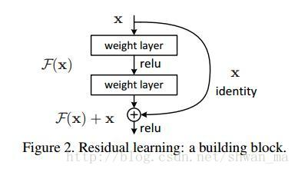
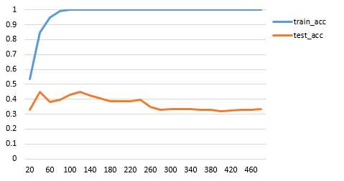
Motivation
A block of
network with
projection shortcut
X · W
Regularization?
L1-norm, L2-norm or something new ?

Slide 3

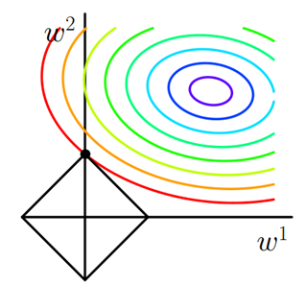
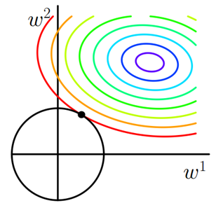


Penalty term
Objective Function
Notes:
Regularization is a way to use some knowledge we already known to modify. Objective function. L1-norm

Slide 4




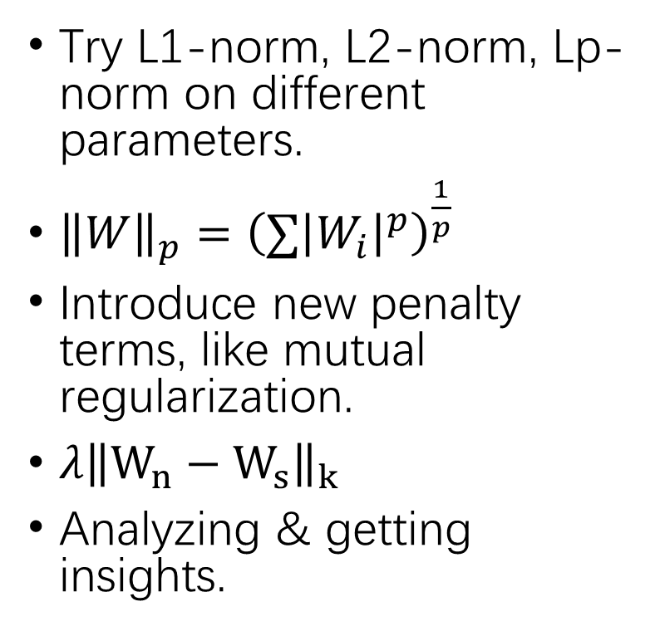
Projection Shortcut
What We Plan To Do
Try L1-norm, L2-norm, Lp-norm on different parameters.
${\left\|W\right\|}_{p}={\left(∑{\left|W_{i}\right|}^{p}\right)}^{\frac{1}{p}}$
Introduce new penalty terms, like mutual regularization.
$λ{\left\|W_{n}−W_{s}\right\|}_{k}$
Analyzing & getting insights.
Wn1
X · Ws
Wn2
$$x$$
$$W_{1}$$
Fully connected layer
relu
X · Ws
$$W_{2}$$
Fully connected layer
$$⊕$$
relu
Notes:
Shortcut prevent deep. Block. vertice

Slide 5
Thank You For Listening! Q & A

Slide 6




$$x$$
$$W_{1}$$
Fully connected layer
relu
X · Ws
$$W_{2}$$
Fully connected layer
$$⊕$$
relu

